Slide 1

Applied Deep Learning Course Project
Detect Cancer Metastasis in Gigapixel Pathology Images
TRANSCENDING DISCIPLINES, TRANSFORMING LIVES

Slide 2
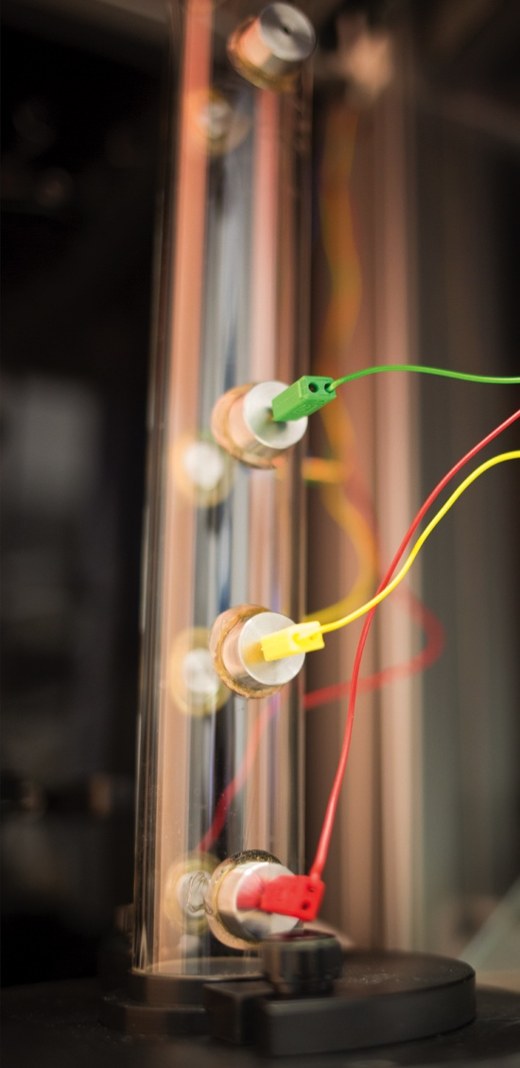
Outline
Introduction
Data Processing
Model
Results
Conclusion
Code Walkthrough
2 | Presentation Title Presentation Title

Slide 3

1. Introduction
3 | Applied Deep Learning Course Project

Slide 4
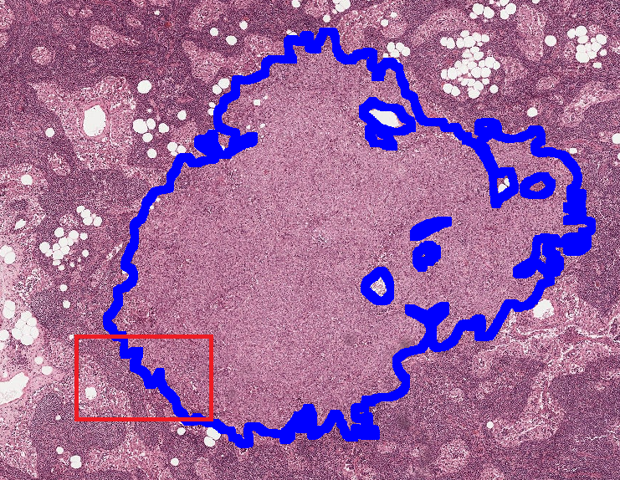
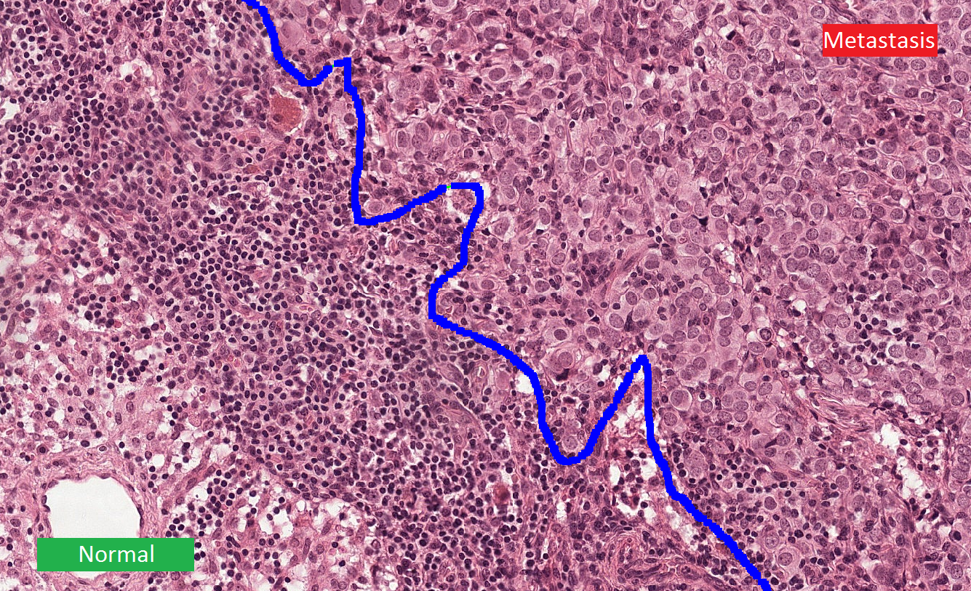
1. Introduction
Background
Lymph nodes are small glands that filter lymph, the fluid that circulates through the lymphatic system.
The lymph nodes in the axilla are the first place breast cancer is likely to spread.
https://camelyon17.grand-challenge.org/Background/
4 | Applied Deep Learning Course Project

Slide 5
1. Introduction
Motivation
The treatment and management of breast cancer is determined by the disease stage, which involves the microscopic examination of lymph node adjacent to the breast.
This process requires highly skilled pathologists and is fairly time-consuming and error prone.
Computer assisted detection of lymph node metastasis could increase the sensitivity, speed and consistency of metastasis detection.
Y. Liu, K. Gadepalli, et al., “Detecting cancer metastases on gigapixel pathology images,” arXiv preprint arXiv:1703.02442, 2017.
5 | Applied Deep Learning Course Project

Slide 6
2. Data Processing
6 | Applied Deep Learning Course Project

Slide 7
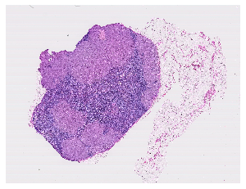
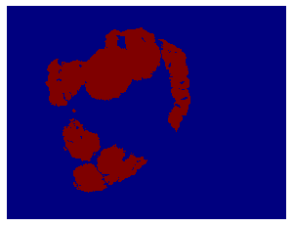
2. Data Processing
Data preparation for training and validation data
Generate mask for slide tumor_038.tif using ASAP
Sanity check
Slide of tumor_110
Mask of tumor_110
7 | Applied Deep Learning Course Project

Slide 8
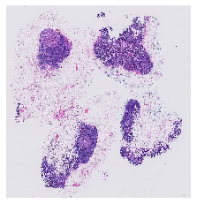
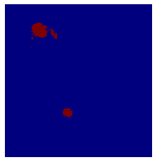
2. Data Processing
Data preparation for test data
Download three slides from test dataset in CAMELYON16
Generate corresponding masks for these slides
Sanity check
Slide of test_001
Mask of test_001
8 | Applied Deep Learning Course Project

Slide 9
2. Data Processing
Dataset split
Total: 25 slides (22 provided and 3 converted by myself)
Training set: 20 slides
Validation set: 2 slides
Test set: 3 slides
9 | Applied Deep Learning Course Project

Slide 10
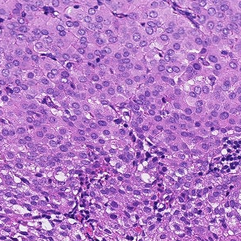
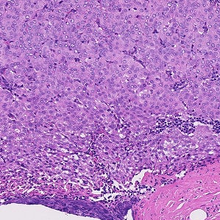
2. Data Processing
Patches extracting
Slide a window across the slides to extract patches
Extract 299 x 299 patches with same center from different levels
Determine label by the 128 x 128 patch of interest
128 x 128 patch of interest
Level 2 Patch
(299 x 299)
Determine the label
Level 3 Patch
(299 x 299)
Surrounding context
10 | Applied Deep Learning Course Project

Slide 11
2. Data Processing
Quality control
Detect tissue part (intensity <= 0.8)
Ignore patches with tissue part < 0.2 of the patch area
Balanced dataset
Resample the tumor patches and normal patches with the same probability.
Training set: 6000 patch at each level (3000 tumor, 3000 normal)
Validation set: 600 patch at each level (300 tumor, 300 normal)
11 | Applied Deep Learning Course Project

Slide 12
3. Model
12 | Applied Deep Learning Course Project

Slide 13
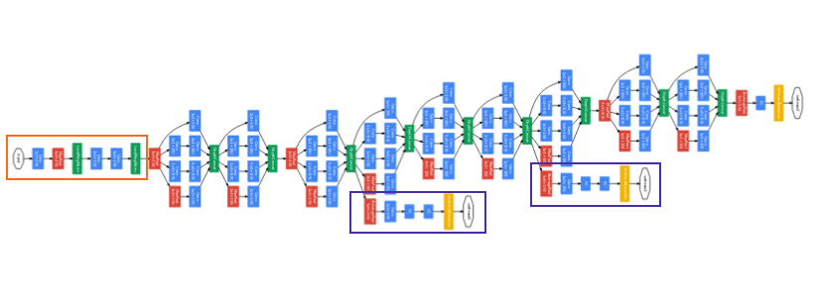
3. Model
Model structure
Two pretrained Inception V3 models
(freeze first 295 layers)
Global Average Pooling layer
Concatenate
Two dense layers
Output
Dense 2
Dense 1
logits
logits
Input (level2)
Input (level3)
13 | Applied Deep Learning Course Project

Slide 14
3. Model
Data augmentation
Horizontal flip
Vertical flip
Width shift
Height shift
Rotation
Brightness
14 | Applied Deep Learning Course Project

Slide 15
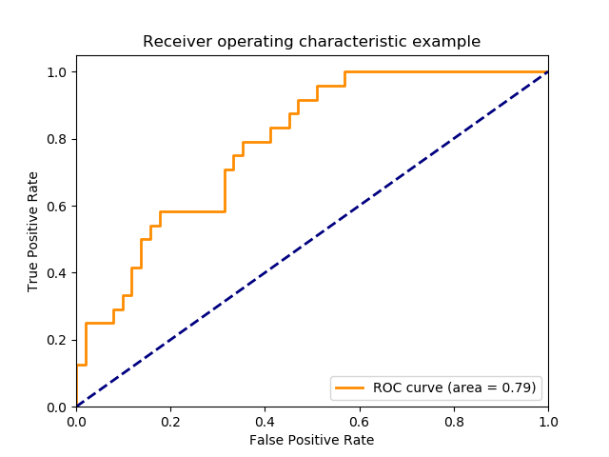

3. Model
Evaluation metrics
AUC: Area Under the ROC Curve
Recall: $\frac{True positive}{True positive + False negative}$
F1 Score: $2×\frac{precision ×recall}{precision+recall}$
Predicted Actual | Tumor (Positive) | Normal (Negative)
Tumor (Positive) | True positive | False negative
Normal (Negative) | False positive | True negative
https://scikit-learn.org/stable/auto_examples/model_selection/plot_roc.html#sphx-glr-auto-examples-model-selection-plot-roc-py
15 | Applied Deep Learning Course Project

Slide 16
4. Results
16 | Applied Deep Learning Course Project

Slide 17
4. Results
Comparison of different models
Transfer learning vs Fine-tuning
Single-scale vs Multi-scale
Input & Model | Number of Trainable Parameters | AUC
Level2-transfer | 524,801 | 0.8728
Level2+3-transfer | 1,049,089 | 0.8818
Level2-fine-tuning | 920,065 | 0.9293
Level2+3-fine-tuning | 1,839,617 | 0.9317
17 | Applied Deep Learning Course Project

Slide 18
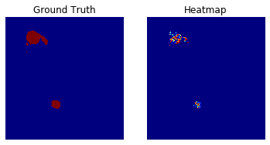
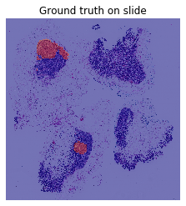
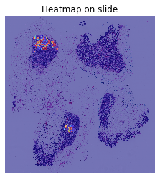
4. Results
Results of test_001
AUC: 0.9332
Recall: 0.8000
F1: 0.6727
18 | Applied Deep Learning Course Project

Slide 19
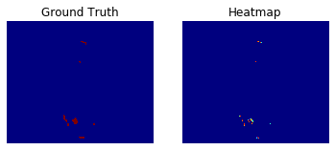
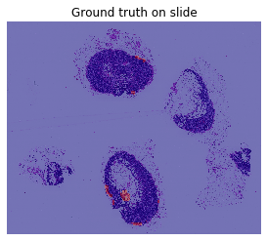
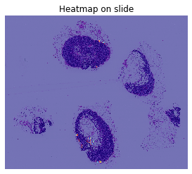
4. Results
Results of test_079
AUC: 0.9516
Recall: 0.4435
F1: 0.6145
19 | Applied Deep Learning Course Project

Slide 20
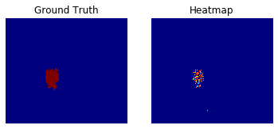
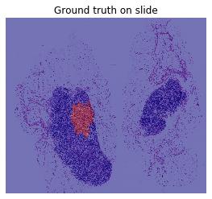
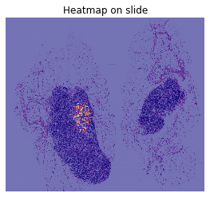
4. Results
Results of test_094
AUC: 0.9112
Recall: 0.5932
F1: 0.7359
20 | Applied Deep Learning Course Project

Slide 21
5. Conclusion
21 | Applied Deep Learning Course Project

Slide 22
5. Conclusion
Using data of higher zoom level will result in more precise result.
Fine-tuning model achieves better result than transfer learning because the slides data are very different from data of ImageNet.
Multi-scale model achieves slightly better result than single-scale model.
22 | Applied Deep Learning Course Project

Slide 23
6. Code Walkthrough
23 | Applied Deep Learning Course Project

Slide 24
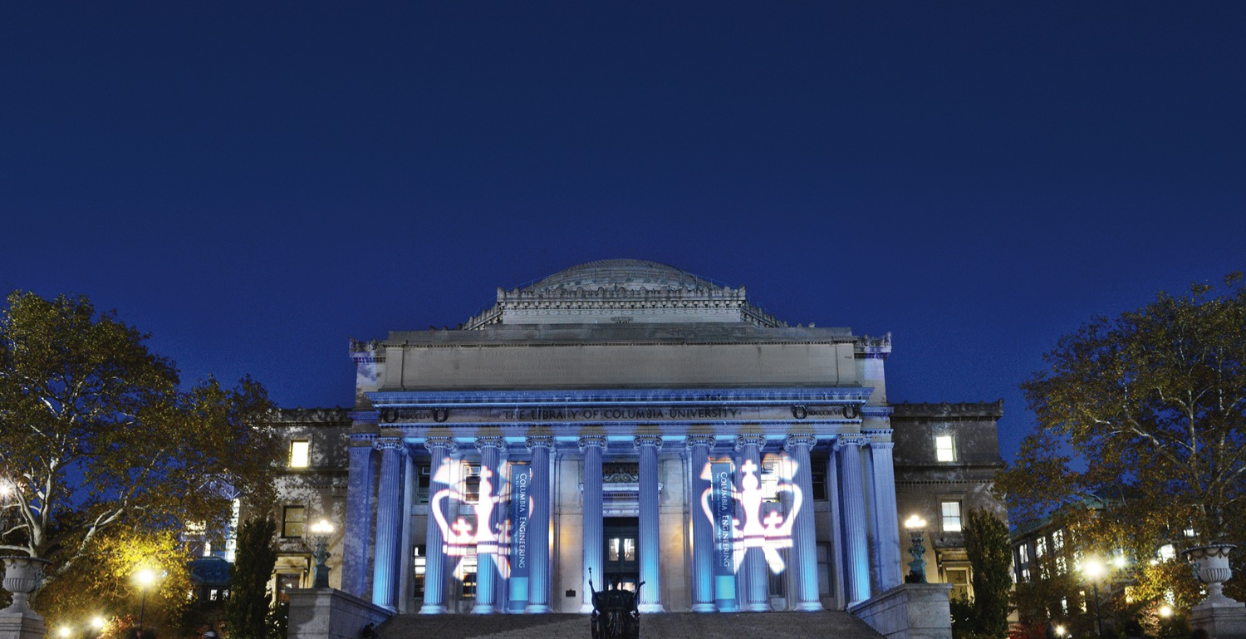
Thank you for listening!
TRANSCENDING DISCIPLINES, TRANSFORMING LIVES

